Slide 1

INDIAN PREMIER LEAGUE WIN PREDICTOR "Predicting IPL Match Outcomes Using Machine Learning"
- Bibek, Gurpreet and Sharad

Slide 2

Prerequisites
Python
Jupyter Notebook
Data analysis and machine learning libraries like numpy, Pandas, matplotlib, and Scikit-learn.
Data Preprocessing
Supervised Machine Learning
Streamlit
VS code
GitHub

Slide 3

Coding Approach
Python
App.py
Sklearn

Slide 4

The Basics behind the win predictor
Utilizing the first innings' performance as a foundation, this application processes current data from the second innings and endeavors to forecast the probability of either team securing a victory.

Slide 5
Importance of Predicting Match Outcomes:
Strategic Advantage for Teams: Accurate prediction helps Informed decision making, power strategy and tactical adjustments.
Enhanced Fan Engagement: Predictions generate anticipation and excitement, interactive experiences and extended fan interest even if their favourite teams are not playing.
Impact on Betting industries: Predictions offer valuable insights and influences betting odd affecting the dynamics of the betting industry. This also contributes to growth of sports betting industry attracting a broader audience.
Financial Implications: Teams with better understanding of match outcomes may attract lucrative sponsorships and endorsement; generating higher revenue through TV, ticket sale etc
Data-Driven Innovation: Predictive analysis in cricket opens avenues for technological advancements in sports analytical.

Slide 6
Steps involved (Visual Studio code)
Importing the Libraries
Read and Load the Data from multiple csv
Exploring and Analyzing the data
Data Preprocessing
Splitting Data into Train and Test Sets
Data Science Model Implementation
Building the Interface
Deploying the webpage

Slide 7
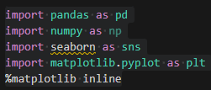
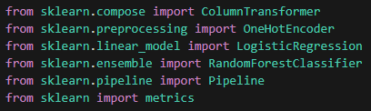

“Importing the Libraries” and “Read & Load the Data from csv
Data tools
Machine Learning
App.py
Matches.csv – Match by match data
Deliveries.csv – ball by ball data

Slide 8

Exploring and Analyzing the data
Shape of our data
Columns/features in data
Length of the dataset
Data information
Checking for null values matches
Checking unique values in required columns

Slide 9

Data Pre-processing
Grouping by deliveries on match id and innings
Merging 2 data frames
Renaming Teams
Handling matches that resulted in the Duckworth lewis system
Merging match_df with deliveries on match_id
Creating necessary columns
Handling null values
Target Variable analysis
Creating Final Data frame

Slide 10
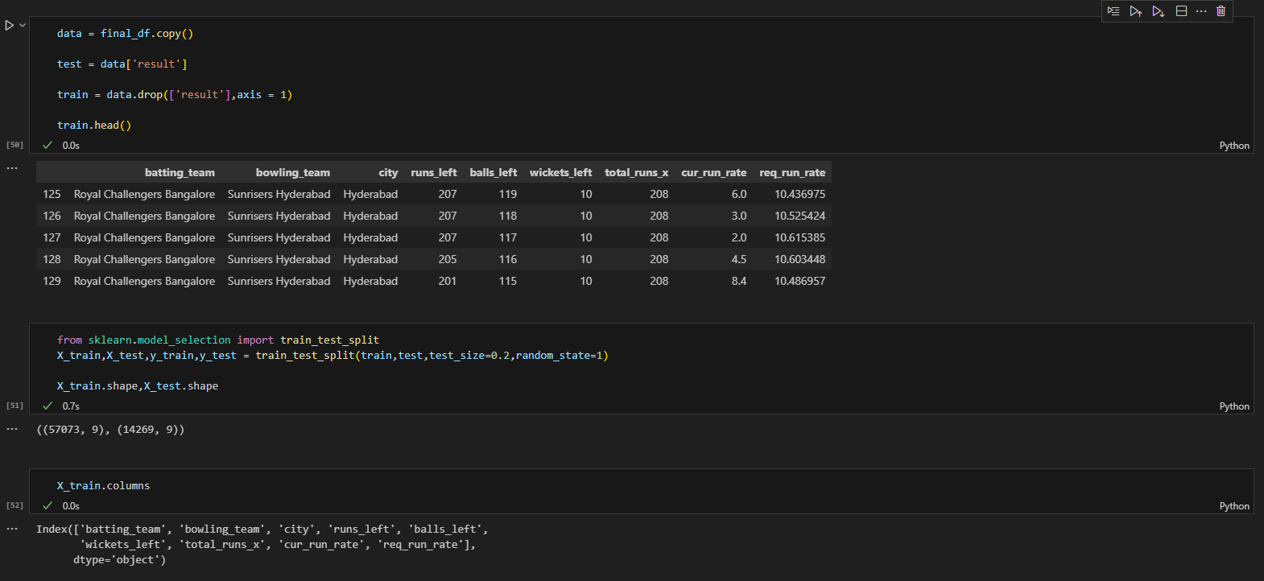
Splitting Data into Train and Test Sets

Slide 11

Data Science Model Implementation
The transformer employed in this context is the OneHotEncoder, designed to convert categorical features into one-hot numeric arrays. The 'sparse' argument is configured as False, indicating that the output will be in the form of a dense array. Setting the 'drop' argument to 'first' ensures that the first category of each column is omitted to prevent collinearity.
The categorical features slated for encoding by the OneHotEncoder are specified by the column names listed in [‘batting_team,’ ‘bowling_team,’ ‘city’].

Slide 12

Data Science Model steps
Implementing Logistic Regression Model
Implementing Random Forest Classifier
Accuracy tests

Slide 13

Building the Interface (App.py)
Absolute path to scripts directory
Load the pretrained model
Declaring the variables such as teams and venue
Setting up the title, columns and layout
Creating various numeric inputs
Scoping various possible results based on inputs provided
Input's validations
Display error messages where inputs is out of scope
Streamlit Launch - Streamlit is an open-source app framework in Python language. It helps us create web apps for data science and machine learning in a short time. It is compatible with major Python libraries such as scikit-learn, Keras, PyTorch, SymPy(latex), NumPy, pandas, Matplotlib etc.

Slide 14
Limitations
Css, Json and HTML limitations; Failed testings with Js code and diversion to Streamlit
Dynamic Nature of Cricket: Cricket is inherently unpredictable, and match outcomes can be influenced by various unforeseen factors, such as player form, weather conditions, and unexpected events during the game. This unpredictability poses a challenge for any win predictor model.
Player Form and Injuries: The model may not account for sudden changes in player form or injuries, which can significantly impact a team's performance.
Team Dynamics: Changes in team dynamics, such as player transfers, captaincy changes, or internal conflicts, are not always reflected in historical data and can affect match outcomes.
External Factors: External factors like pitch conditions, crowd support, and home ground advantage can influence match results but may not be adequately captured in the dataset.
Model Complexity: While complex models might offer high accuracy, they can be challenging to interpret, making it difficult for users to understand the rationale behind predictions.

Slide 15
Recommendations
Continuous Model Evaluation and Updating: Regularly evaluate the model's performance and update it based on new data, accounting for changes in team dynamics, player form, and other relevant factors.
Incorporate Real-Time Data: Integrate real-time data feeds during matches to capture dynamic changes in player performance, weather conditions, and other game-specific variables.
Feature Engineering: Explore additional features that might contribute to better predictions, such as recent player performance metrics, player head-to-head statistics, or team-specific strategies.
User Education: Provide users with clear information about the model's limitations and uncertainties. Educate users on the dynamic nature of cricket and the inherent challenges in predicting match outcomes.
Ensemble Models: Consider using ensemble models that combine the strengths of multiple algorithms to improve overall prediction accuracy and mitigate the weaknesses of individual models.
Feedback Mechanism: Implement a feedback mechanism where users can provide feedback on predicted outcomes, helping to fine-tune the model and enhance its accuracy over time.
Interpretability: Focus on creating models that are not only accurate but also interpretable. A transparent model allows users to understand the reasoning behind predictions and increases trust in the system.
Collaboration with Cricket Experts: Collaborate with cricket experts to gain insights into the nuances of the game that might not be apparent from data alone. Their expertise can help refine the model and improve its predictive capabilities.

Slide 16

Interesting fact
IPL continues to gain popularity on a global scale as well, ranking as the second most popular sports event after the English Premier League. It surpasses other major sports events such as NFL, NBA, Major League Baseball, and T20 Cricket World Cup. The report suggests that IPL is expected to surpass EPL and become the most popular sporting event worldwide

Slide 17

Sources
About Dataset - https://www.kaggle.com/datasets/nowke9/ipldata
Indian Premier League (IPL) is a Twenty20 cricket format league in India. It is usually played in April and May every year. As of 2019, the title sponsor of the game is Vivo. The league was founded by Board of Control for Cricket India (BCCI) in 2008.
Content:
Data till Season 11 (2008 - 2019)
Matches.csv – Match by match data
Deliveries.csv – ball by ball data
Acknowledgements
Data source from 2008-2017 - CricSheet.org and Manas - Kaggle
Data source for 2018-2019 - IPL T20 - Official website

Slide 18

Thank you & questions

